Slide 1
Excess COVID-19 Deaths Modeling
Davit Sargsyan Last Updated: 1/2/2024

Slide 2
Data processing and subsetting
Data: Excess Death Month_cause_State_ ETS Forecast_2023_11_AddUS_TO_SEND.csv
Long description | Label
COVID-19 (U07.1) | COVID-19
Influenza and pneumonia (J09-J18) | Influenza and pneumonia
Chronic lower respiratory diseases (J40-J47) | Lungs
Cerebrovascular diseases (I60-I69) | CVD
Diseases of heart (I00-I09,I11,I13,I20-I51) | Heart
Essential hypertension and hypertensive renal disease (I10,I12,I15) | Hypertension
Malignant neoplasms (C00-C97) | Cancer
Diabetes mellitus (E10-E14) | Diabetes
Chronic liver disease and cirrhosis (K70,K73-K74) | Liver
Alzheimer disease (G30) | Alzheimer
Parkinson disease (G20-G21) | Parkinson
Septicemia (A40-A41) | Septicemia
Intentional self-harm (suicide) (U03,X60-X84,Y87.0) | Suicide
Accidents (unintentional injuries) (V01-X59,Y85-Y86) | Accidents
Not top 15 | Other
DeathDaily = Death/DaysMonth (i.e., average daily death = average monthly death/number of days in that month)
Rate = 10^5*DeathDaily/Population
Divided data into:
Training1: 1/1/2015 to 2/1/2019
Testing 1: 3/1/2019 to 2/1/2020
COVID-19: 3/1/2020 to 6/1/2022
Post-COVID: 6/1/2022 to 9/1/2023

Slide 3
US Population
Note: 2023 populations were not available, so 2022 populations were copied as 2023. Can we update this?

Slide 4
% Population Change from January 2015

Slide 5
US Deaths by Cause and State
Suicide and accidental deaths numbers are probably incorrect for 2023. Can we update these?
At the same time deaths from Other causes increased in 2023. Are these numbers absorbing suicides and accidents?
Click on the icon below to open the PDF

Slide 6
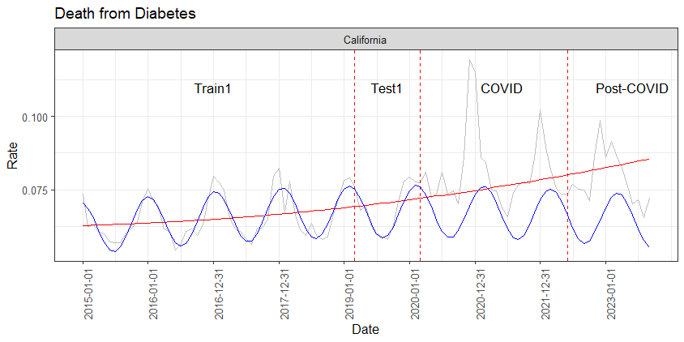
Example: Death from Diabetes in California
Grey: observations
Red: linear model with a quadratic term (lm):
Rate ~ dt + dt_sqr
Blue: nonlinear least square model (nls::nls)
Rate ~ b0 + b1*dt + b2*dt_sqr + b3*sin(b4 + b5*dt)
Mean Absopute Percent Error (MAPE):
MAPE = 100*mean(abs(Observed_Rate – Predicted_Rate)/(Observed_Rate )
Parameter | Interpretation | Estimate | Std. Error
b0 | Y-intercept | -0.549162862 | 0.965873886
b1 | Linear slope | 0.000067631 | 0.000112475
b2 | Square term, i.e. non-linearity of the trend | -0.000000002 | 0.000000003
b3 | Wave magnitude | -0.008976364 | 0.000730201
b4 | Sin shift to the left | -0.156743146 | 3.624588264
b5 | Wavelength (> 1 shortens, < 1 elongates). Starting value was 1/60 = 0.016(6) | 0.016745471 | 0.000210939

Slide 7
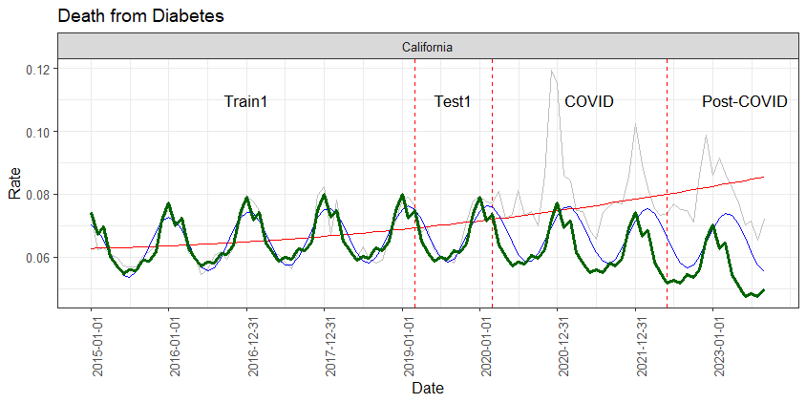
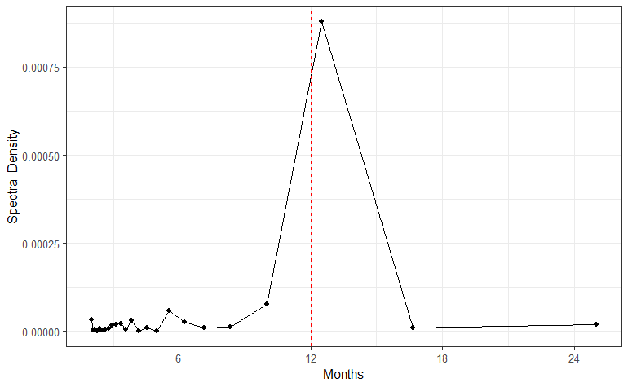
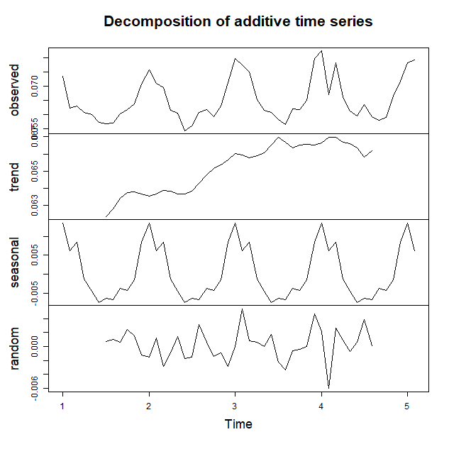
Seasonality Model of Death from Diabetes in California
State | Set | MAPE (NLS) | MAPE (Seasonal)
California | Train1 | 4.32 | 3.24
California | Test1 | 3.29 | 4.67
California | COVID | 15.48 | 21.89
California | Post-COVID | 18.15 | 29.96

Slide 8
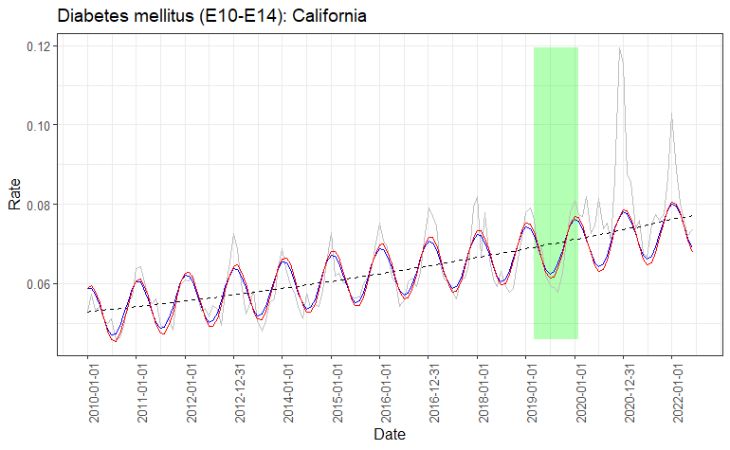
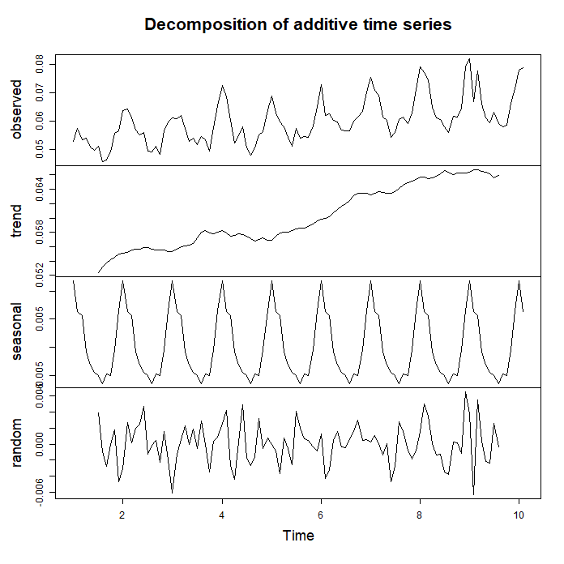
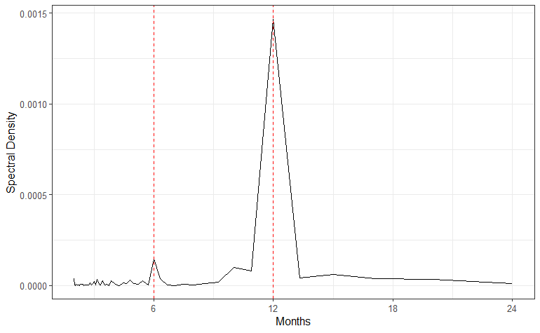
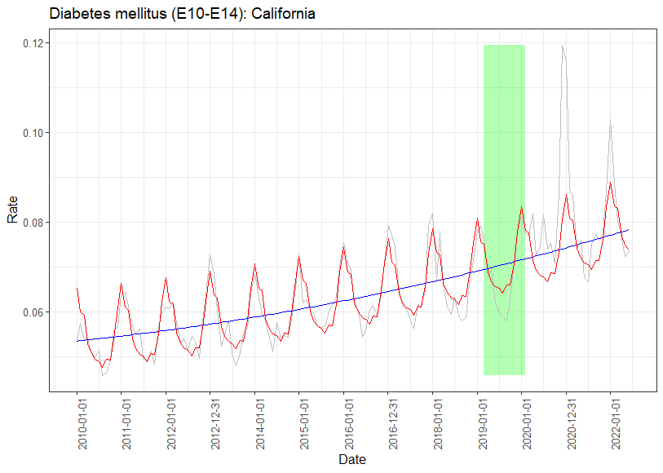
Previous Results
Set | MAPE (NLS) | MAPE (Seasonal)
Training | 4.75 | 3.98
Testing | 5.03 | 4.41
COVID-19 | 10.00 | 8.00

Slide 9
Previous Results Part I: 2010-2022 Data with Causes of Death

Slide 10
Only the states that reached at least 10 CVD deaths daily were kept in the analysis

Slide 12
Mixed-effects nonlinear model
Rate ~ b0 + b1*dt + b2*dt^2 + b3*sin(b4 + b5*dt) | State
where b0: y-intersept; b1: linear trend; b2: quadratic term; b3: wave magnitude; b4: wave offset left; b5: wavelength.
Cause of death | b0 | b1 | b2 | b3 | b4 | b5
Alzheimer disease (G30) | 0.4277 | -5.40E-05 | 2.04E-09 | 0.0119 | 15.14 | 0.0171
Cerebrovascular diseases (I60-I69) | 0.4727 | -4.78E-05 | 1.61E-09 | 0.0107 | 14.67 | 0.0172
Chronic lower respiratory diseases (J40-J47) | -0.1350 | 2.89E-05 | -7.55E-10 | 0.0226 | 13.80 | 0.0172
Diabetes mellitus (E10-E14) | 0.0154 | 3.97E-06 | -4.42E-11 | 0.0070 | 13.43 | 0.0172
Diseases of heart (I00-I09,I11,I13,I20-I51) | 1.1233 | -7.92E-05 | 2.72E-09 | 0.0547 | 14.26 | 0.0172
Influenza and pneumonia (J09-J18) | -0.3035 | 4.26E-05 | -1.29E-09 | 0.0170 | 14.89 | 0.0171
Malignant neoplasms (C00-C97) | 0.1835 | 4.27E-05 | -1.34E-09 | 0.0096 | 14.47 | 0.0172
Other_rev | 0.1453 | 3.95E-05 | -2.92E-13 | 0.0501 | 14.64 | 0.0172
Other diseases of respiratory system (J00-J06,J30- J39,J67,J70-J98) | 0.0644 | -7.29E-06 | 3.33E-10 | 0.0043 | 14.42 | 0.0172

Slide 13
Mixed-effects nonlinear model Mean Absolute Percent Error
MAPE = 100*mean(abs(Rate - prd3)/(Rate)))
Cause of Death | Training | Testing | COVID-19
Alzheimer disease (G30) | 8.65 | 14.21 | 28.05
COVID-19 (U07.1) | 6.64 | 7.38 | 14.91
Cerebrovascular diseases (I60-I69) | 5.06 | 5.39 | 5.99
Chronic lower respiratory diseases (J40-J47) | 6.11 | 5.85 | 14.80
Diabetes mellitus (E10-E14) | 3.11 | 2.93 | 6.20
Diseases of heart (I00-I09,I11,I13,I20-I51) | 15.66 | 14.61 | 39.57
Influenza and pneumonia (J09-J18) | 2.16 | 2.12 | 3.01
Malignant neoplasms (C00-C97) | 2.80 | 2.43 | 7.66
Other diseases of respiratory system (J00-J06,J30- J39,J67,J70-J98) | 8.65 | 14.21 | 28.05
Other_rev | 9.39 | 10.91 | Inf

Slide 14
Mixed-effects nonlinear model Excess Death
Deaths_prd := prd3*daysmonth*Population*10^(-5)
Excess Death (% predicted) = 100*sum(Deaths - Deaths_prd)/sum(Deaths_prd)
Cause of Death | Training | Testing | COVID-19
Alzheimer disease (G30) | 8.65 | 14.21 | 28.05
COVID-19 (U07.1) | 6.64 | 7.38 | 14.91
Cerebrovascular diseases (I60-I69) | 5.06 | 5.39 | 5.99
Chronic lower respiratory diseases (J40-J47) | 6.11 | 5.85 | 14.80
Diabetes mellitus (E10-E14) | 3.11 | 2.93 | 6.20
Diseases of heart (I00-I09,I11,I13,I20-I51) | 15.66 | 14.61 | 39.57
Influenza and pneumonia (J09-J18) | 2.16 | 2.12 | 3.01
Malignant neoplasms (C00-C97) | 2.80 | 2.43 | 7.66
Other diseases of respiratory system (J00-J06,J30- J39,J67,J70-J98) | 8.65 | 14.21 | 28.05
Other_rev | 9.39 | 10.91 | Inf

Slide 15
State | Observed Death During Testing Months (2019/03/01 to 2020/02/28, % Predicted)
 | Alzheimer disease (G30) | Cerebrovascular diseases (I60-I69) | Chronic lower respiratory diseases (J40-J47) | Diabetes mellitus (E10-E14) | Diseases of heart (I00-I09,I11,I13,I20-I51) | Influenza and pneumonia (J09-J18) | Malignant neoplasms (C00-C97) | Other_rev | Other diseases of respiratory system (J00-J06,J30- J39,J67,J70-J98)
Alabama | -11.1 | 1.0 | -4.3 | 7.7 | -1.6 | -1.7 | -2.3 | 1.1 | -11.8
Arizona | -9.8 | -4.6 | -10.0 | -2.5 | -0.3 | 11.9 | 0.9 | 0.3 | -7.8
California | -6.3 | -2.0 | -0.7 | -0.8 | -1.1 | -2.0 | 0.2 | 2.1 | -0.1
Florida | -19.3 | -0.4 | -3.6 | -0.2 | -1.2 | 3.2 | 0.3 | 0.2 | 0.0
Georgia | -16.9 | -6.6 | -6.8 | -2.4 | 1.5 | -1.7 | 0.8 | 3.0 | -9.8
Illinois | -11.1 | -0.1 | -1.6 | -4.1 | -1.4 | -3.2 | -0.5 | -1.2 | -12.3
Indiana | -13.2 | 5.2 | 2.1 | -6.3 | -0.6 | -3.6 | 1.0 | -1.0 | -1.1
Maryland | -20.7 | 1.0 | 3.7 | 2.8 | -0.1 | -10.6 | -0.8 | -2.5 | -7.6
Michigan | -9.8 | -0.1 | 2.4 | 5.7 | -2.6 | 2.4 | 0.6 | -0.2 | 2.8
Missouri | 3.3 | -3.8 | -5.5 | 1.5 | -1.2 | -12.2 | -0.7 | -1.9 | 6.6
New Jersey | -14.0 | 0.7 | -3.1 | 7.4 | -2.5 | 0.8 | -0.5 | -0.2 | 5.0
New York | -7.4 | -3.5 | 2.6 | 5.5 | -1.9 | 0.6 | 0.0 | 1.3 | 11.0
North Carolina | -8.5 | -2.9 | -3.8 | -4.2 | -0.5 | -7.5 | 0.0 | -0.1 | -8.6
Ohio | -8.8 | -0.5 | -0.9 | 1.4 | -0.1 | -10.0 | -0.9 | -2.0 | -9.1
Pennsylvania | -9.6 | -0.4 | -1.9 | -2.1 | -2.7 | -6.2 | 0.5 | -1.7 | -3.3
South Carolina | -22.4 | -8.6 | -7.1 | 2.4 | -2.6 | -6.7 | -0.8 | 0.5 | 13.4
Tennessee | -14.9 | -2.7 | -3.2 | 10.4 | 1.5 | -8.2 | -0.5 | 2.1 | 12.9
Texas | -11.6 | -7.4 | 0.3 | 11.3 | -2.2 | 5.6 | 2.2 | 2.2 | -10.7
Virginia | -5.8 | 1.5 | 9.1 | 4.0 | 0.6 | -9.3 | 0.5 | 0.7 | 1.5
Washington | -9.3 | -4.5 | -2.8 | -1.3 | 0.4 | 2.0 | 0.0 | 1.9 | 0.2

Slide 16
State | Observed Death During COVID-19 (2020/03/01 to 2022/06/01, % Predicted)
 | Alzheimer disease (G30) | Cerebrovascular diseases (I60-I69) | Chronic lower respiratory diseases (J40-J47) | Diabetes mellitus (E10-E14) | Diseases of heart (I00-I09,I11,I13,I20-I51) | Influenza and pneumonia (J09-J18) | Malignant neoplasms (C00-C97) | Other_rev | Other diseases of respiratory system (J00-J06,J30- J39,J67,J70-J98)
Alabama | -16.4 | -4.1 | -15.1 | 44.9 | 4.6 | -10.3 | -2.4 | 7.9 | -10.8
Arizona | -22.3 | -1.8 | -15.9 | 5.3 | 7.8 | 11.9 | 1.6 | 12.6 | -8.5
California | -11.1 | 0.2 | -7.0 | 12.7 | 2.9 | -11.6 | 2.5 | 14.3 | -12.5
Florida | -25.0 | -0.2 | -13.0 | 21.2 | 1.4 | 12.6 | 2.0 | 6.8 | -12.4
Georgia | -24.4 | -4.0 | -11.8 | 14.1 | 7.1 | 5.5 | 1.3 | 14.4 | -6.5
Illinois | -13.9 | 1.2 | -10.2 | 13.7 | 0.0 | -11.5 | -1.5 | -1.0 | -19.5
Indiana | -26.0 | 3.0 | -5.8 | 11.3 | 0.5 | -16.3 | 1.9 | 2.5 | -6.7
Maryland | -19.7 | -1.2 | -6.8 | 18.5 | 1.7 | -30.2 | -1.4 | -5.0 | -36.2
Michigan | -19.6 | 2.2 | -10.6 | 23.1 | -0.9 | -8.9 | 1.0 | 3.2 | -9.6
Missouri | -11.5 | 3.1 | -8.4 | 13.9 | 3.2 | -16.4 | 3.8 | 3.9 | -3.6
New Jersey | -24.4 | 1.2 | -11.3 | 32.4 | -2.5 | 11.8 | -1.0 | -4.9 | 13.9
New York | -22.7 | -0.8 | -9.9 | 15.9 | 0.4 | -0.4 | -0.2 | 5.2 | 7.1
North Carolina | -21.6 | -1.4 | -16.0 | 10.3 | 3.5 | -22.7 | 0.0 | 5.8 | -13.2
Ohio | -13.3 | 3.3 | -10.3 | 17.5 | 1.3 | -17.0 | -1.2 | -2.0 | -10.1
Pennsylvania | -12.0 | 0.1 | -10.6 | 14.1 | -3.4 | -21.7 | 1.2 | -1.1 | -12.4
South Carolina | -27.4 | -4.9 | -14.4 | 4.5 | 2.8 | -33.1 | -2.8 | 5.1 | 5.7
Tennessee | -24.2 | 8.2 | -10.8 | 33.7 | 9.6 | -11.5 | 2.0 | 14.0 | 13.3
Texas | -16.6 | -2.6 | -6.6 | 28.3 | 2.8 | 10.7 | 4.2 | 14.1 | -15.0
Virginia | -17.6 | 3.0 | -5.6 | 9.6 | 5.0 | -13.6 | 1.9 | 7.9 | -8.5
Washington | -14.3 | -5.7 | -7.3 | 15.9 | 4.8 | -46.2 | 3.2 | 13.5 | -9.7

Slide 17
PCA on observed daily death (as % of predicted)
Influenza death were higher than predicted in TX, FL, AZ, GE and NJ
Diabetes deaths exceeded the predicted the most in NJ, NY and TN

Slide 18
Population dynamics (% Jan 2010) in the US 51 states between Jan 2010 and June 2022
Error bars indicate 95% CI calculated on the Testing data
Green dots are the observed deaths as % of predicated, by State
The model underestimated deaths from Alzheimer even during the Testing years
During COVID-19 years, the predicted death caused by Alzheimer, Chronic Lower Respiratory and Influenza were much lower that expected from the Testing set, while Diabetes death was much higher than expected

Slide 19
Part II: 2015-2023 Data without Causes of Death

Slide 20
Data processing and subsetting
DeathDaily = Death/daymonth (i.e., average daily death = average monthly death/number of days in that month)
Data starts at 2015-01-01. Removed records: Date >= 2023-05-01
Divided data into training (before 2019/03/01), testing (2019/03/01 to 2020/02/28 or 29) and Covid-19 (2020/03/01 to 2022/06/01)
Calculated Rate (no more zeros) = 10^5*(Deaths/(daymonth*Population)
NOTE: if there were zeros then Rate = 10^5*(Deaths + 1)/(daymonth*(Population + 1))

Slide 21
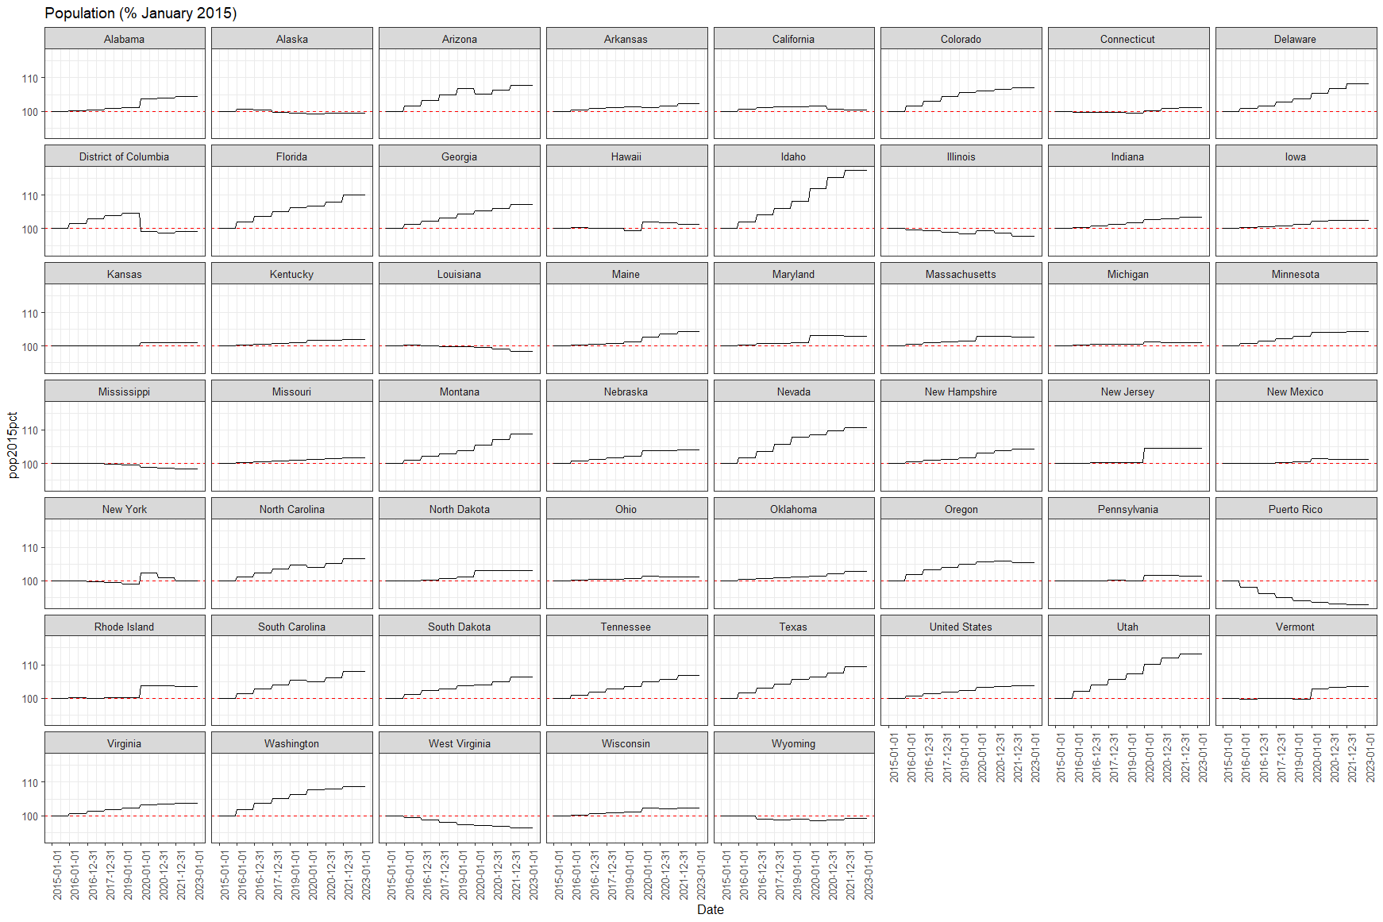
Population dynamics in the US states and territories
by State between Jan 2015 and May 2023

Slide 22
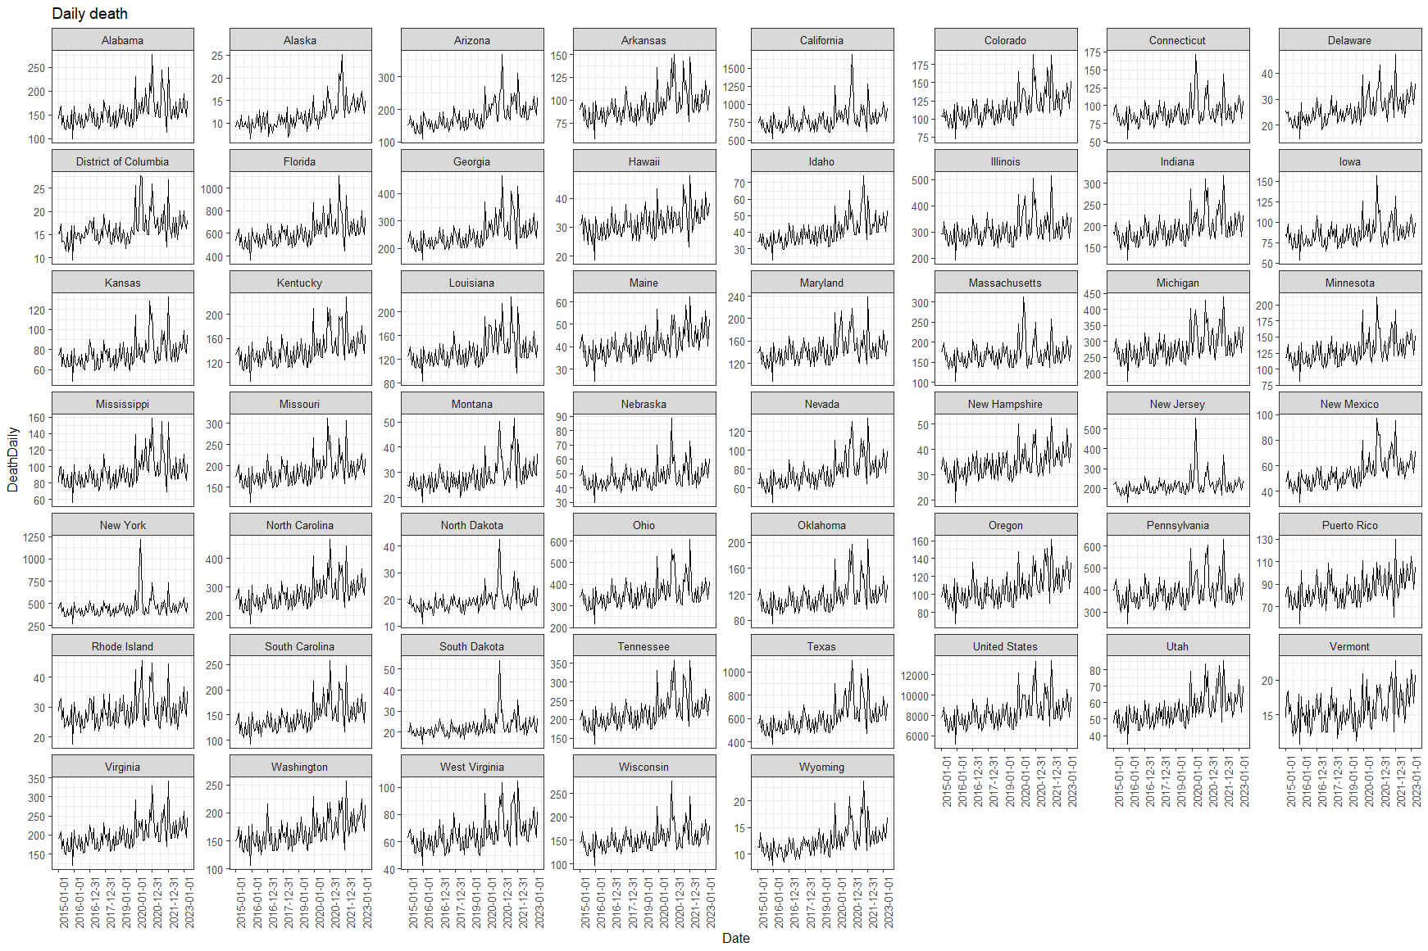
Daily All-Cause Death in the US states and territories
by State between Jan 2015 and May 2023

Slide 23
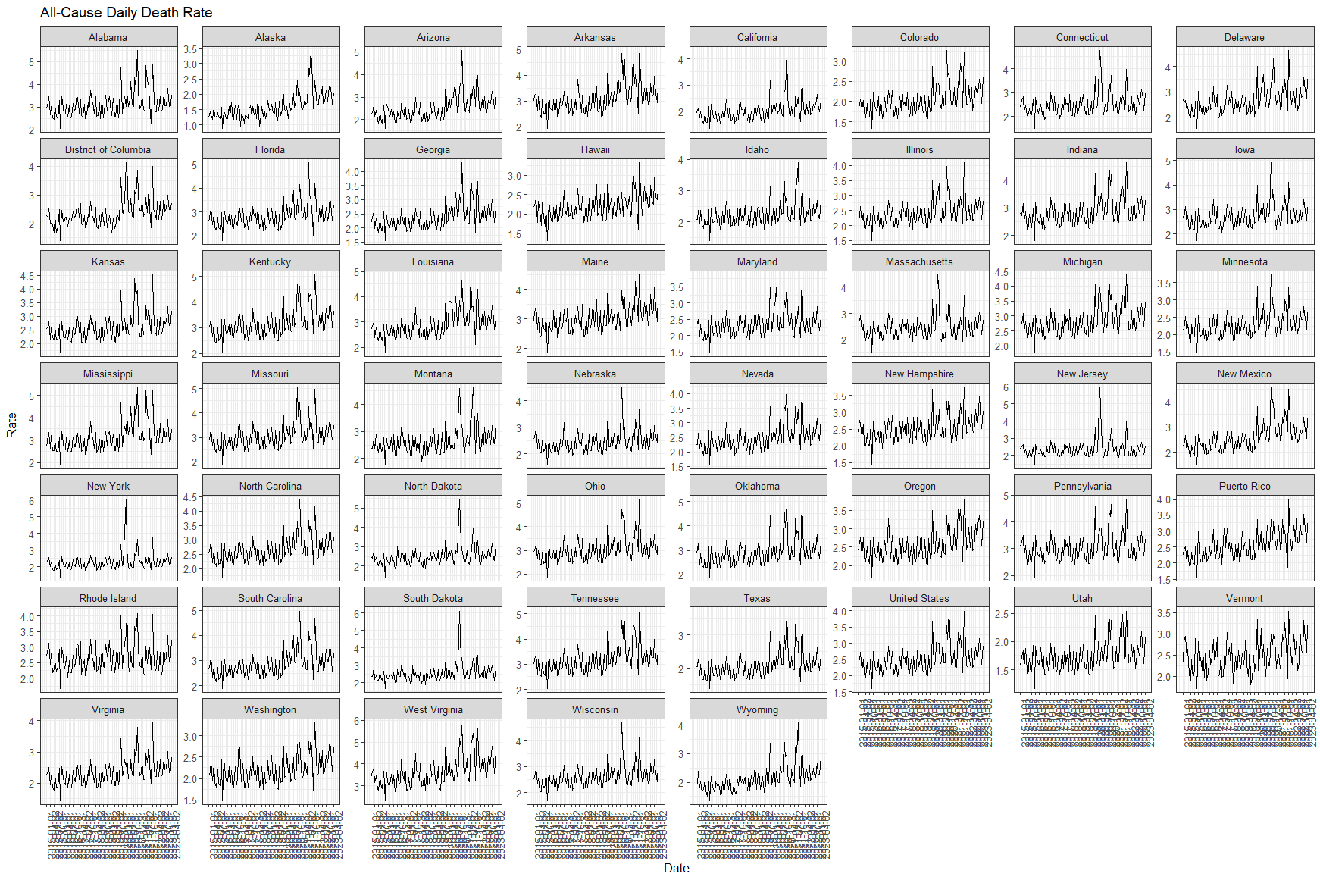
Daily All-Cause Death Rate in the US states and territories
by State between Jan 2015 and May 2023, per 10^ of Population

Slide 24
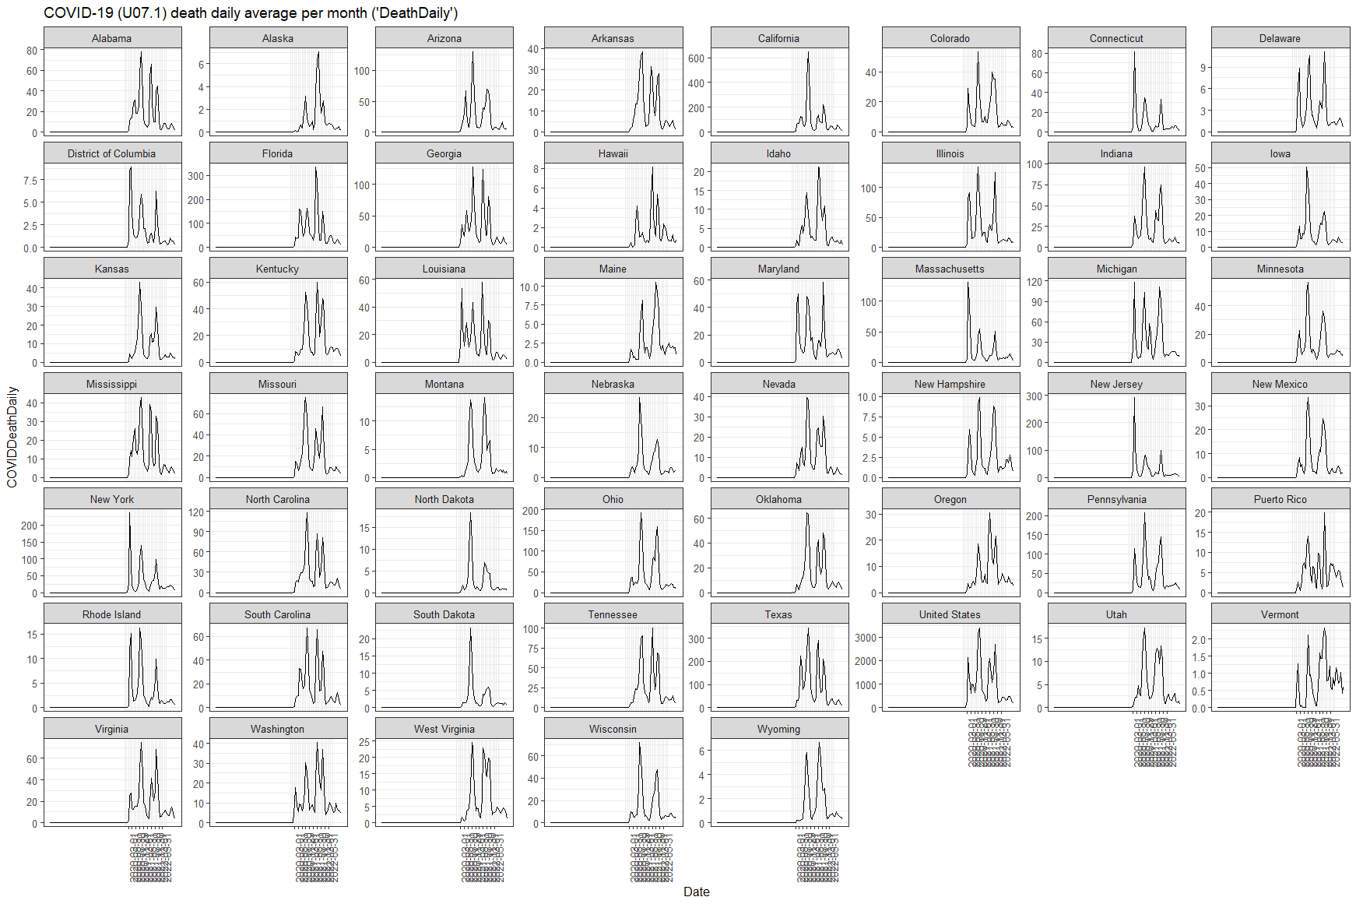
Daily COVID-19 Death in the US states and territories
by State between Jan 2015 and May 2023

Slide 25
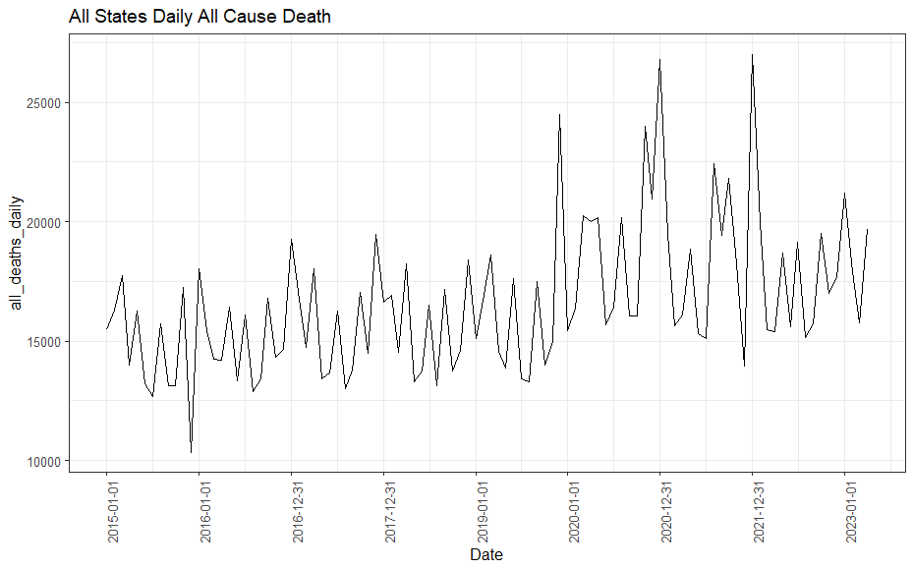
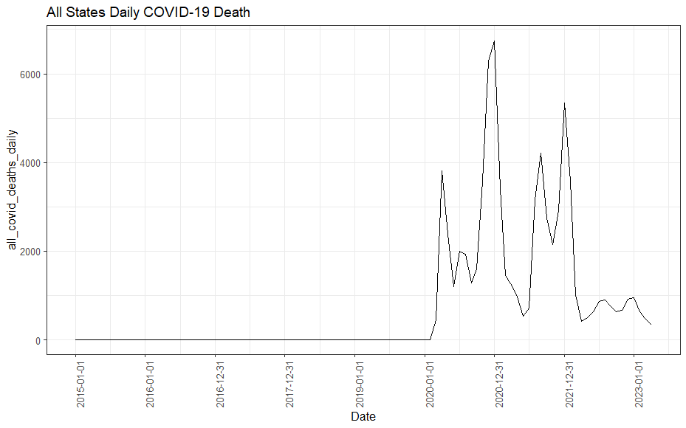
Daily COVID-19 Death in the US states and territories
All States Combined between Jan 2015 and May 2023

Slide 26
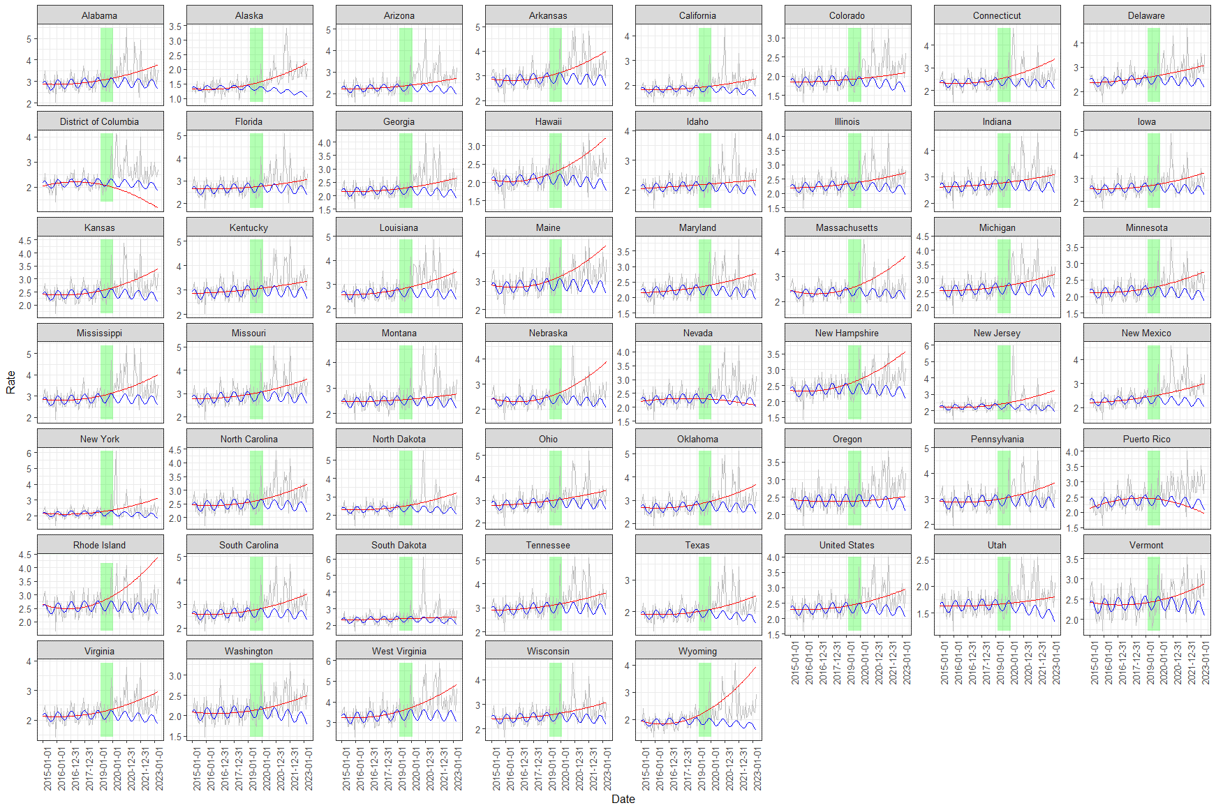
Daily All-Cause Death Rate in the US states and territories
by State between Jan 2015 and May 2023, per 10^ of Population
Quadratic and Sinusoidal Fits

